Slide 1

the effect of male pipefish and brood pouch Length on egg intake during mating
By: Farah Atatrah

Slide 2
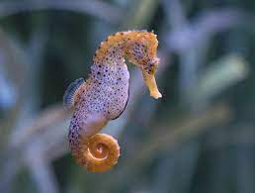
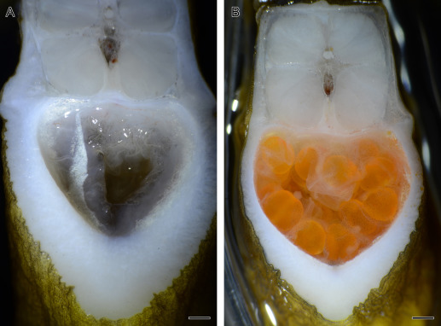
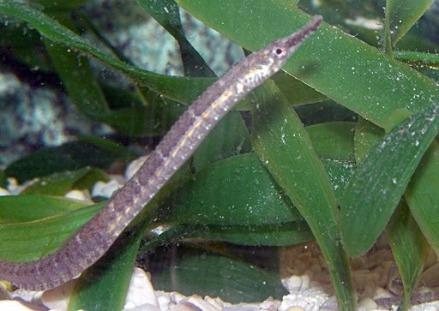
Background: Syngnathidae
Male Pregnancy
Brood Pouch
Syngnathidae

Slide 3
Research Question: Does the size of the male pipefish and brood pouch affect the number of eggs they take in during mating?
Null hypothesis: There is no effect on the egg intake based on the length of the male pipefish and brood pouch.
Alternative hypothesis: There is an effect on the egg intake based on the length of the male pipefish and brood pouch.

Slide 4


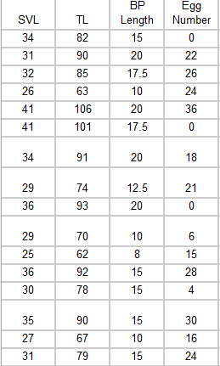
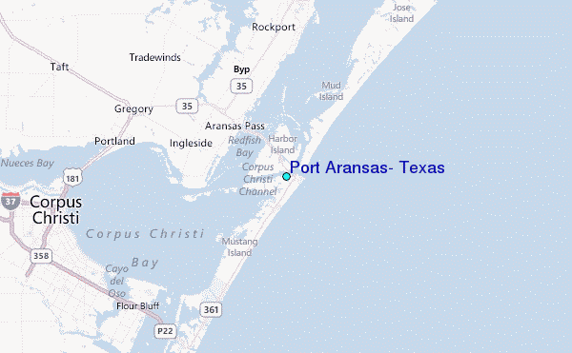
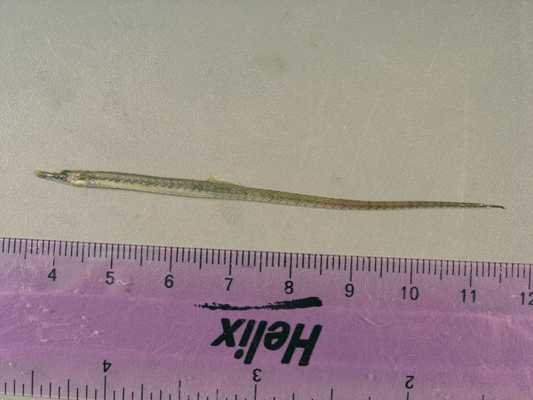
Methods
Measured 23 males’ brood pouch length and SVL ( snout-vent length)
Counted the number of eggs through visual estimation
This only accounts for the males collected in 2023

Slide 5
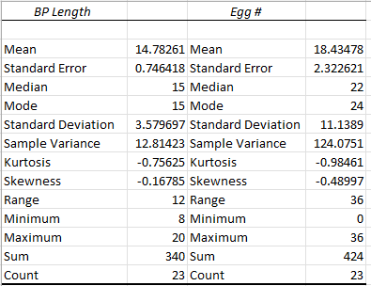
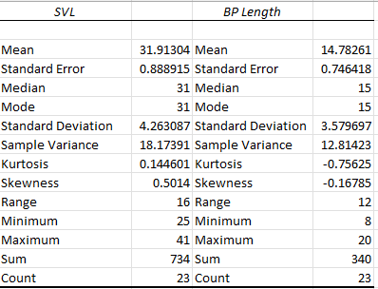
DESCRIPTIVE STATISTICS

Slide 6
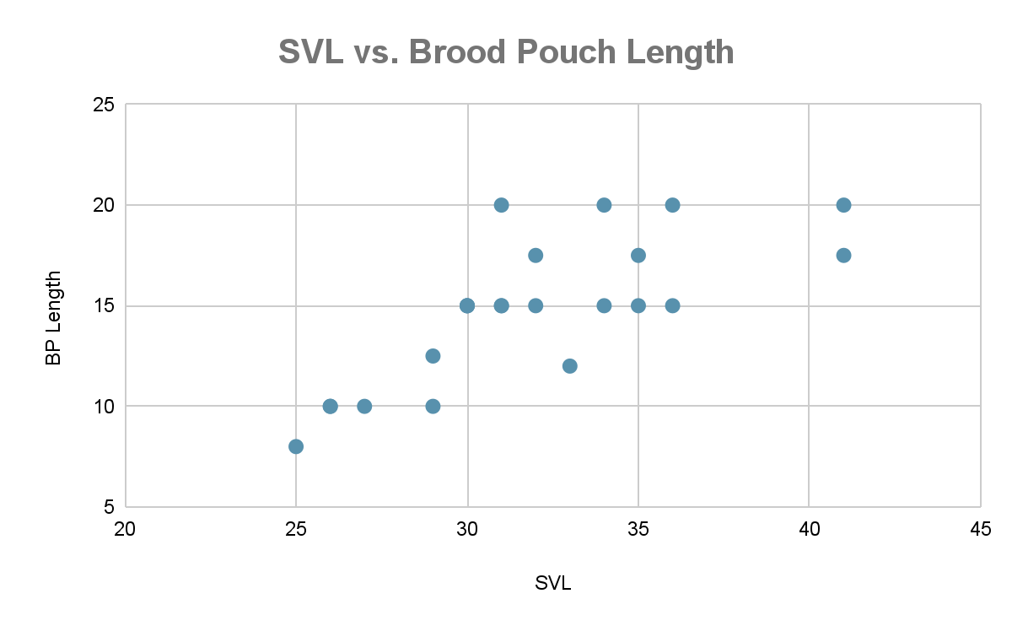
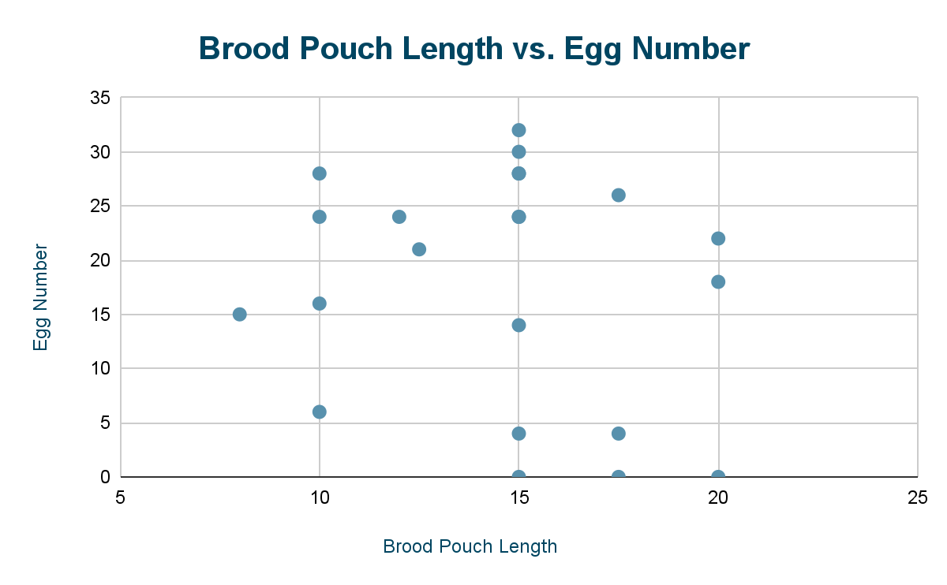
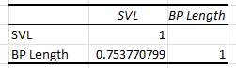
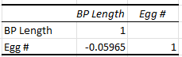
Scatter Plots & Correlation

Slide 7
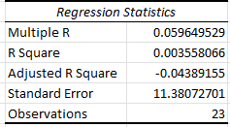
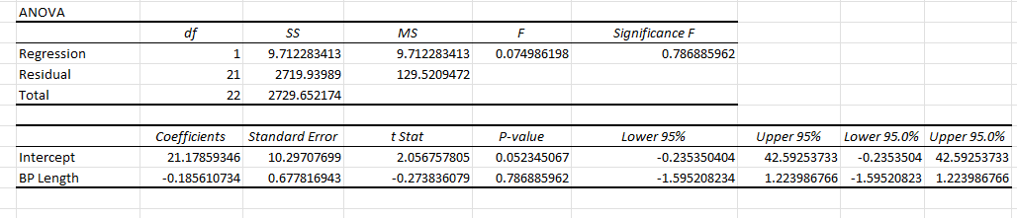
Statistical Test: Regression

Slide 8
Statistical Test: Regression Plots

Slide 9
Conclusion
Based on the Based on the regression analysis and ANOVA results:
The p-value is 0.786 which is greater than 0.05
The f statistic is 0.0749
The large p-value and small f-statistic suggest that we failed to reject the null hypothesis
There is no significant difference in the number of eggs based on the length of male pipefish and brood pouch

Slide 10
discussion
In the Research Paper: Pipefish embryo oxygenation, survival, and development: egg size, male size, and temperature effects
This paper suggests:
as the size of the brood pouch increases, the number of egg intake increases
the smaller males have higher embryo survival than the larger males
Larger males are more concerned with embryo size while smaller males with survival

Slide 11
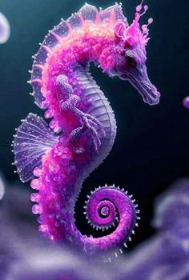
Thinking points
Reasoning for egg number variability:
Having fewer number of eggs due to behavioral possibilities
Interruption in mating
The female has mated before and that’s the number of eggs she has left
lack of variability
species, locations, environment, and years
Possible error due to visual examination

Slide 12
Sources
https://www.jstor.org/stable/24835061?casa_token=tDRMpk1xBvAAAAAA%3AccIRgn3Bac2jjyjspgkyQRmX191s5sajNssgyIuir7sa7KG7xXDVmKgBRq-s_uV_DEtfcQEHXpP2X7rWVPL7Rv1SC1XI29EApFWewXe6pZkThpJhlrY&seq=1
https://academic.oup.com/beheco/article/30/5/1451/5525172
Dr. Scobell

Slide 13

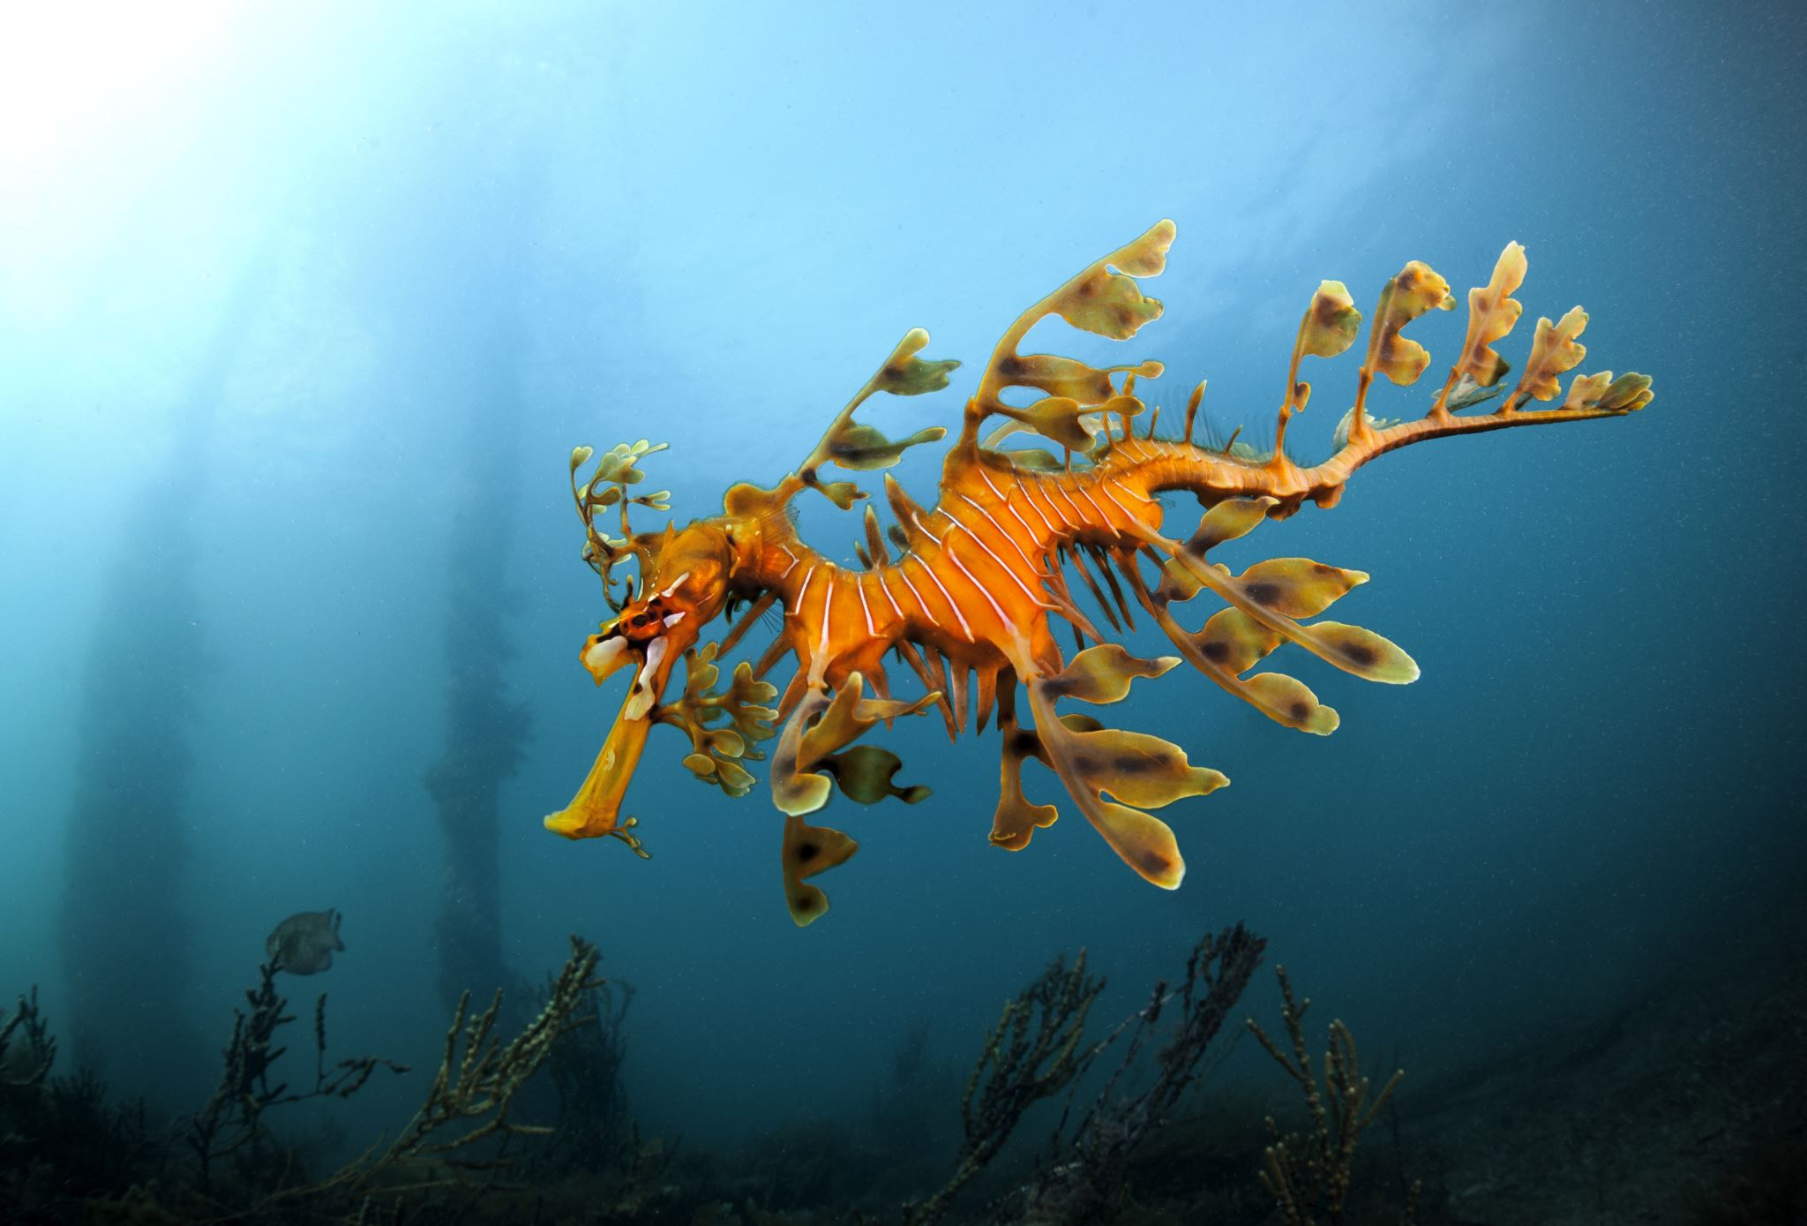
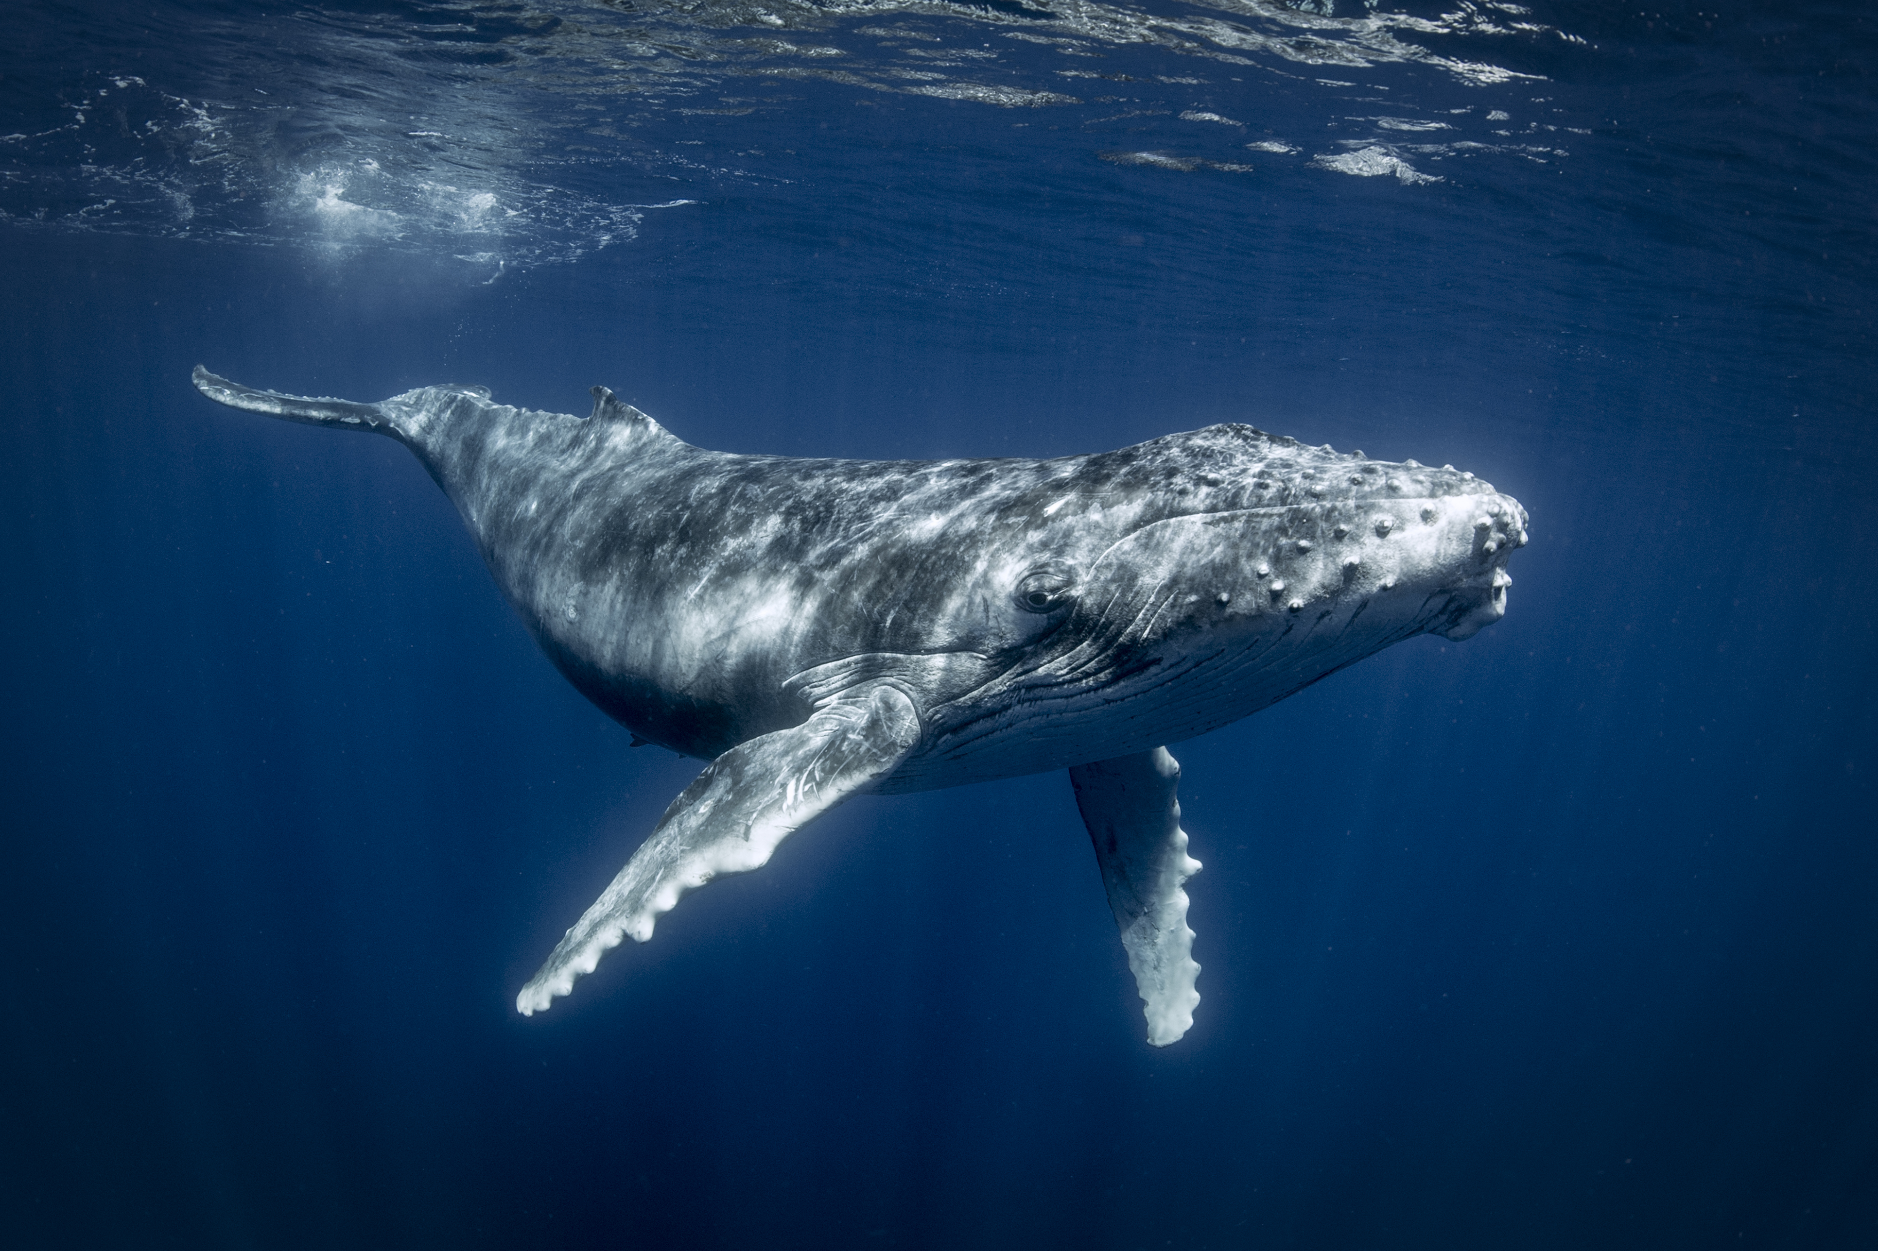
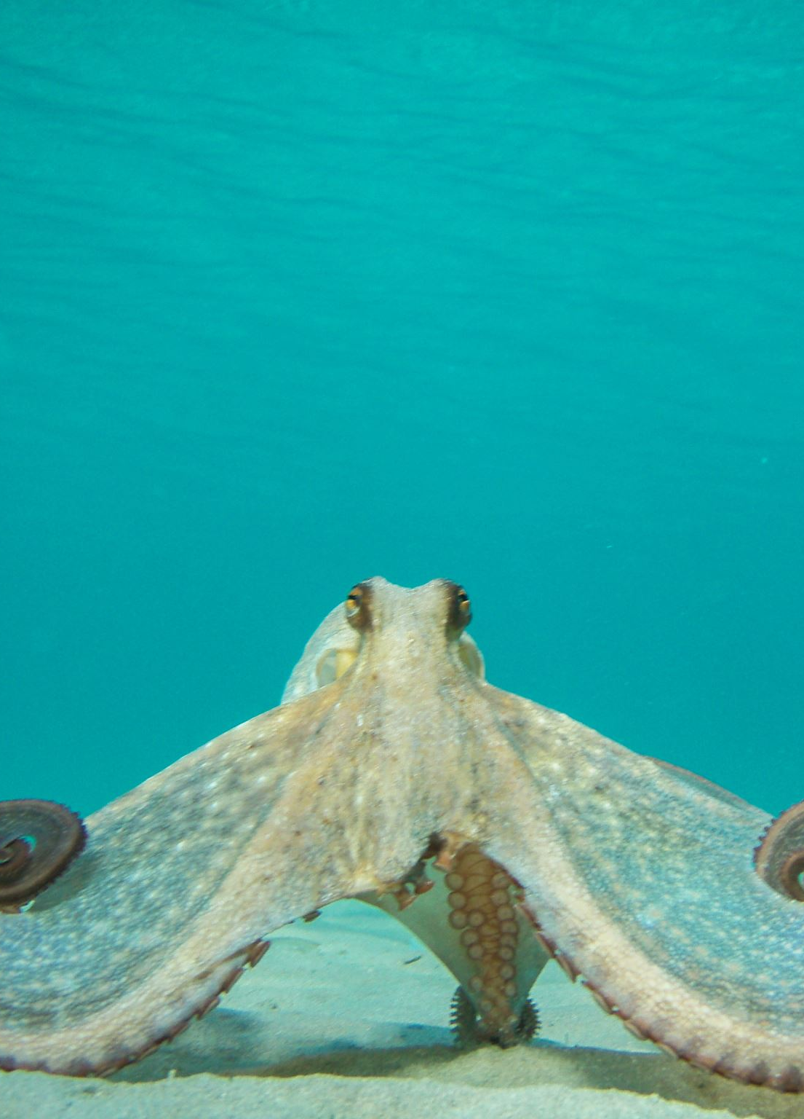
Thank you ☺

